Slide 1
MAJOR PROJECT
Care For All
MENTOR-

Slide 2
Our Team
1. Shagun Mutreja (CSE 7X- 1802200)
2. Rishav Singla (CSE 7X- 1802175)

Slide 3

Problem Explained

Slide 4
OBJECTIVE
The objectives of the project are:
- To make users aware about the diseases and their prescribed meditations by qualified doctors for the patients.
- It is an eco-friendly idea to avoid the wastage of medicine at our home by re- cycling or donating through website before its expiry.
- To provide the user with fastest and cheapest way to get prescribed medicines consulted by qualified doctors

Slide 5
Related Work

Slide 6
RELATED PREVIOUS WORK
A lot of this work has already been done in this field.
Websites like Netmeds, ApolloPharmacy, IndiaMart, PharmEasy etc are there which provide you home delievery services for medicines.
But we are not only focusing on providing medicines for free or at lower cost and providing information of disease but also, in future, we are providing a chatbox windows for contacting best doctors for treatment.

Slide 7
Software and Hardware Requirements

Slide 8
Software and Hardware
Requirements
Software Requirements:
Can run on any web browser
Hardware Requirements:
Laptop/ computer
Core i3 8th generation
Mobile Phones

Slide 9
Proposed Method

Slide 10
PROPOSED METHODOLOGY
Step 1) Developing a UI Interface for the website with user authentiction.
Step 2) The website will include profile maintainance, post medicine details, medicine manager, post disease and find disease.
Step 3) Connecting the whole website to a database so that we can have a record of user’s information, medicines information and disease information.
Step 4) Creating an admin dashboard to recognise malicious activities.
Step 5) Maintaining login sessions.

Slide 11
Deliverables

Slide 12
DELIVERABLES
Major output of the project: is to provide needy people a platform to get prescribed medicines free and purchase at lower cost.
The second objective: of this project is to help people to find proper recommendations of doctors for some diseases.
Future objective: is provide patients a chat box window to consult the doctors and get appointment without going anywhere.

Slide 13
Gantt Chart

Slide 14
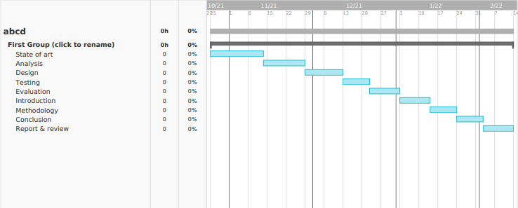
GANTT CHART

Slide 15
References

Slide 16
REFERENCES
https://www.w3schools.com/whatis/whatis_fullstack.asp
https://www.guru99.com/full-stack-developer.html
https://www.javatpoint.com/angular-7-tutorial
https://www.tutorialspoint.com/angular4/index.htm
https://getbootstrap.com/docs/4.0/getting-started/introduction/
https://fontawesome.com/v4.7.0/icons/
https://www.w3schools.com/jquery/

Slide 17

Thank You ☺

